Slide 1
SUSCEPTIBILITY ACCORDING TO H.A ROBERT
PRESENTED BY :
DR.SONNY MON .R
ASSISTANT PROFESSOR
DEPT.OF. ORGANON

Slide 2
Susceptibility According to H. A Robert
(Herbert A. Roberts, MD )
He begins “Everything that has life is more or less influenced by circumstances and environment”

Slide 3
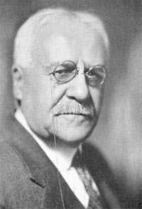
“One man’s meat is another man’s poison”

Slide 4
SUSCEPTIBILITY IN VEGETABLE KINGDOM :

Slide 5
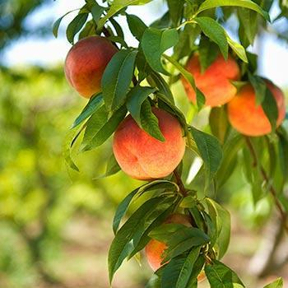
1.Certain flora develop fully only in certain altitudes and when swept by the constant moisture of the ocean. They will take on an entirely different form under other circumstances and environment.
Examples :
Connecticut a state of US -study conducted on peach trees and the soil. They have come to the conclusion that lack of potash in the soil lead to failure in producing peaches and that happened in Connecticut .

Slide 6
SUSCEPTIBLITY IN ANIMAL KINGDOM :

Slide 7
Animals from certain parts of the earth’s surface develop peculiarities of their own which are entirely different from their close relatives elsewhere.

Slide 8
Examples :
1.The polar bear is immune to the rigours of the Arctic, but is susceptible and soon succumbs to the influence of warm climates

Slide 9
2. The Bengal tiger thrives in the humidity of the Indian jungles , other members of the tiger family have adapted themselves to the altitude and rarefied atmosphere of the slopes of the Himalayas and searching winds of those heights.

Slide 10
SUSCEPTIBILITY AND HUMANBEING
Susceptibility and climatic conditions :
He says One person will thrive in a rigorous climate where another will become seriously ill. One will thrive in dampness to which another would succumb.
Altitude affects some individuals little and some adversely.
The seashore improves one man’s condition while it makes another man ill.

Slide 11
Susceptibility and Nutrition :
“One man’s meat is another man’s poison”
1.One easily assimilates a certain kind of food while another finds the same food indigestable
Susceptibility and Infection :
1.Human beings are susceptible to infection and contagion in varying degrees.
One man will become infected in contact with diseased individuals while another will experience no ill effects whatever.

Slide 12
Susceptibility and Similimum :
Susceptibility varies in degree in different patients and at different times in the same patient .
A patient may be susceptible to a number of remedies, but the greatest susceptibility is manifest in the most similar the similimum.
In sickness susceptibility is exaggerated, thus we need to be careful in conserving the normal susceptibility. It is only in the administration of the similar remedy the normal susceptibility will be regained.
If administration of medicines are not based on symptom similarity the results are either palliative or suppressive and the ultimate result is complete destruction.

Slide 13
SUSCEPTIBILITY AND CONSTITUTION :
Certain families are susceptible to certain type of diseases where as the neighborhood families are not affected by that. Because certain traits of susceptibility are manifest in family groups, and thus they are susceptible to certain diseases.

Slide 14
Thus THE SIMILAR REMEDY OR THE SIMILAR DISEASE, SATISFIES SUSCEPTIBILITY AND ESTABLISHES IMMUNITY

